Slide 1


Topic-Video Conferencing (SIP)
NATIONAL INSTITUTE OF TECHNOLOGY, SILCHAR
Guided By –
Umakanta Majhi Sir
Presented By - Shiva Agarwal
Notes:
To use this title animation slide with a new image simply 1) move the top semi-transparent shape to the side, 2) delete placeholder image, 3) click on the picture icon to add a new picture, 4) Move semi-transparent shape back to original position, 5) Update text on slide.

Slide 2

What are Video Conferencing ???
Video conferencing is a technology that allows users in different locations to hold face-to-face meetings without having to move to a single location together. This technology is particularly convenient for business users in different cities or even different countries because it saves time, expenses, and hassles associated with business travel. Uses for video conferencing include holding routine meetings, negotiating business deals, and interviewing job candidates.

Slide 3
CONTENTS
What is SIP?
Real World Example
Two Types of Packet
Media packet transfer on IP network
Good Reason For The Protocol
Definition Of SIP
What is History Of SIP
SIP provides 5 services for establishing and terminating a session
Flow of SIP message Between Two User Agent
References

Slide 4


Session Initiation Protocol
What is SIP
?
Protocol Initiation Session
Protocol That Initiate the Session

Slide 5
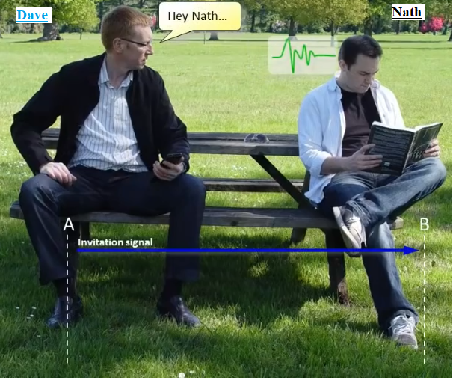
Real world
Example

Slide 6
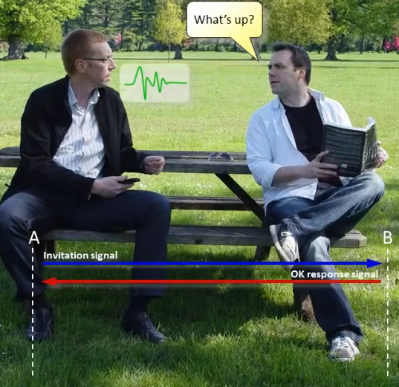
Real world
Example

Slide 7
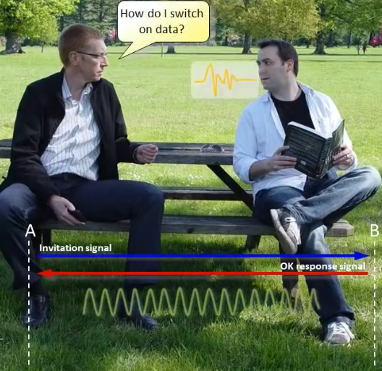
Real world
Example

Slide 8
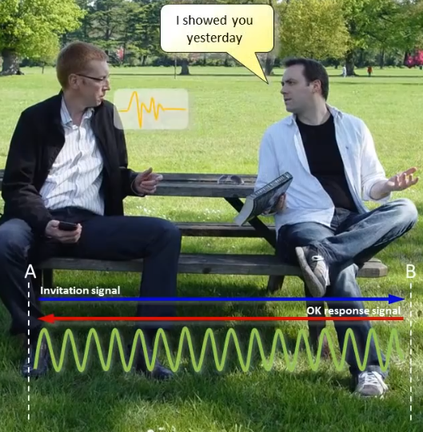
Real world
Example

Slide 9
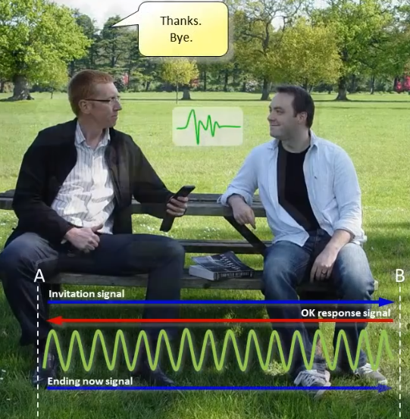
Real world
Example

Slide 10
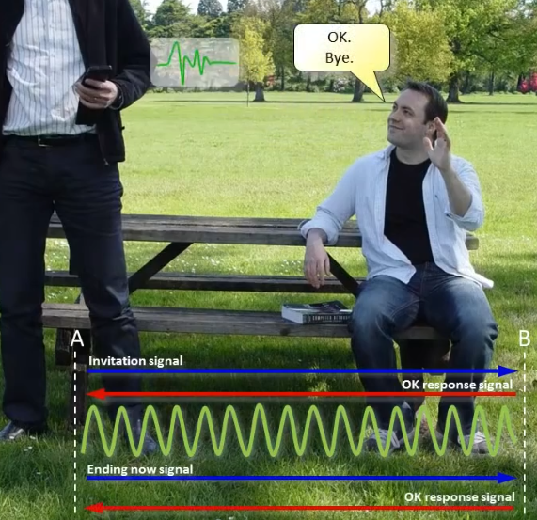
Real world
Example

Slide 11
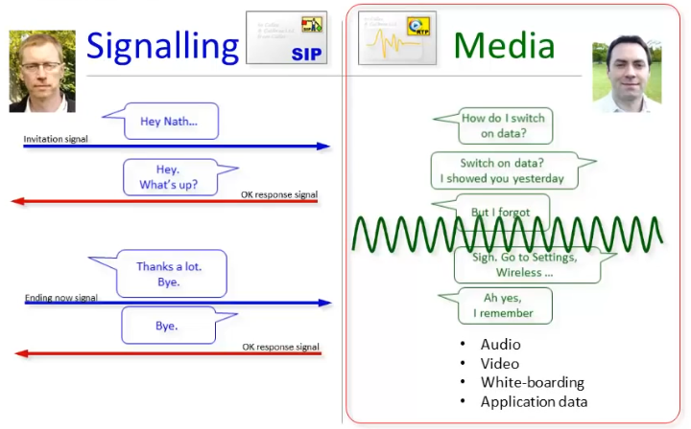
There are Two Types of Packet

Slide 12
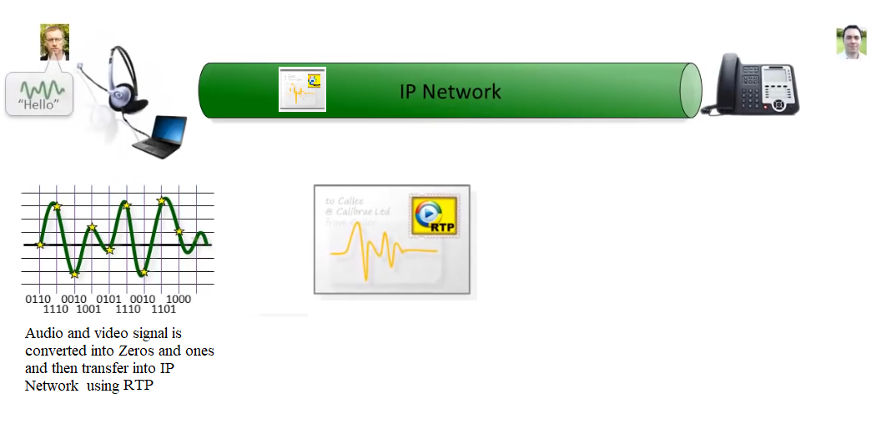
Media packet transfer on IP network

Slide 13
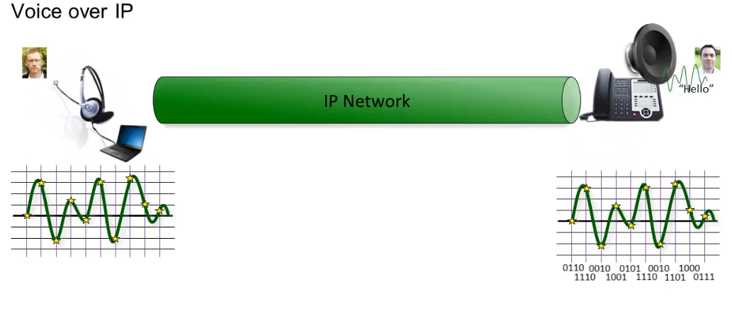
Media packet transfer on IP network

Slide 14

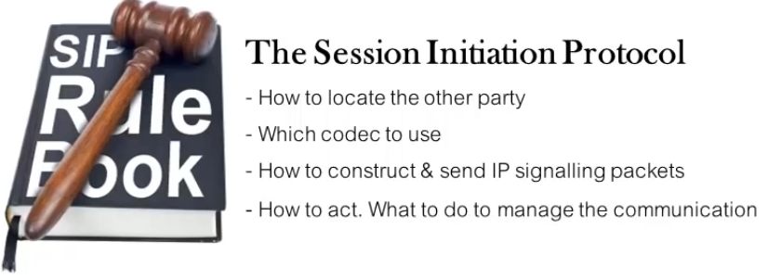
Both Parties know each other's location (address)
How to locate the other user's ip address?
Both parties use the same codecs
How to decide which codec to use?

Slide 15
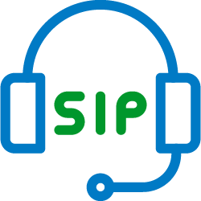
Definition of SIP
?
The Session Initiation Protocol (SIP) is a signaling protocol used for initiating, maintaining, and terminating real-time sessions that include voice, video and messaging applications.
SIP is used for signaling and controlling multimedia communication sessions in applications of Internet telephony for voice and video calls, in private IP telephone systems, in instant messaging over Internet Protocol (IP) networks as well as mobile phone calling over LTE (VoLTE)

Slide 16
What is History Of SIP
?
SIP was originally designed by Mark Handley, Henning Schulzrinne, Eve Schooler and Jonathan Rosenberg in 1996 to facilitate establishing multicast multimedia sessions on the Mbone.
The protocol was standardized as RFC 2543 in 1999. In November 2000, SIP was accepted as a 3GPP signaling protocol and permanent element of the IP Multimedia Subsystem (IMS) architecture for IP-based streaming multimedia services in cellular networks. In June 2002 the specification was revised in RFC 3261 and various extensions and clarifications have been published since.

Slide 17
SIP provides 5 services for establishing and terminating a session:
* User capabilities: determination of the media and media parameters to be used.
* Session setup: “ringing”, establishment of session parameters at both called and calling party.
* User location: determination of the end system to be used for communication
* User availability: determination of the willingness of the called party to engage in communications;
* Session management: including transfer and termination of sessions, modifying session parameters, and invoking services.

Slide 18
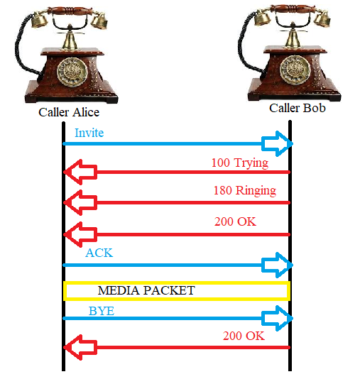
Flow of SIP message Between Two User Agent
It takes 7 message to Set up and Tear Down the call.
3 message are Request and 4 are Response.
Request – Begin with a method type and a request URI Address.
Response – Include state code and reason.
Notes:
Combine an image and multiple key statements with a strong grid.

Slide 19

THANK YOU FOR YOUR ATTENTION!
ANY
QUESTION?

Slide 20
References
http://www.cse.chalmers.se/~tsigas/Courses/DCDSeminar/Files/sip.pdf
https://en.wikipedia.org/wiki/Session_Initiation_Protocol
Casner, Stephen; Deering, Stephen (July 1992). "First IETF Internet Audiocast". ACM SIGCOMM Computer Communication
Miikka Poikselkä; Georg Mayer; Hisham Khartabil; Aki Niemi (19 November 2004), The IMS: IP Multimedia Concepts and Services in the Mobile Domain, John Wiley & Sons, p. 268, ISBN 978-0-47-087114-0
https://www.youtube.com/watch?v=u40P-ZUv2R8

